Slide 1
York Code Dojo
Chris Maughan
mornymorny@gmail.com
Coder @ NVIDIA

Slide 2
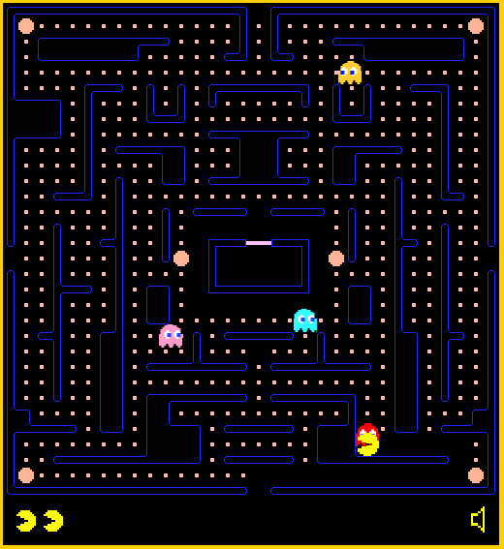
“Pacman”

Slide 3
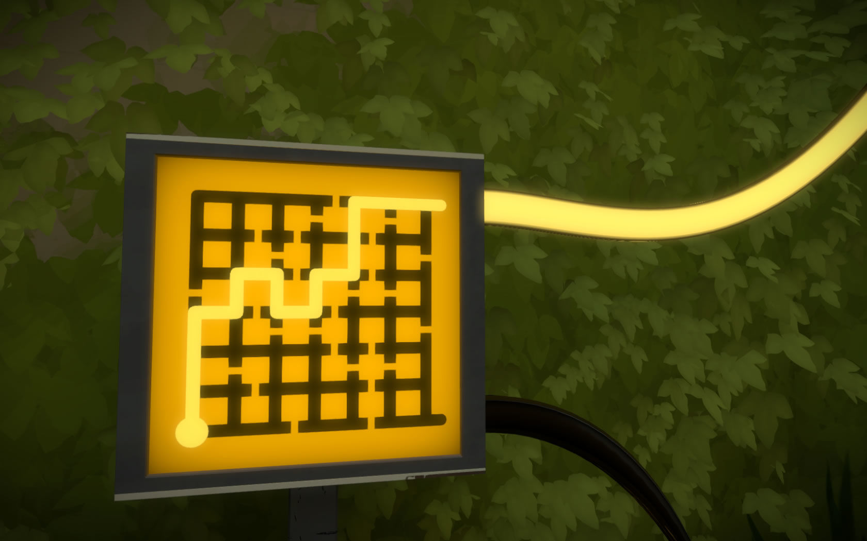
“The Witness”

Slide 4
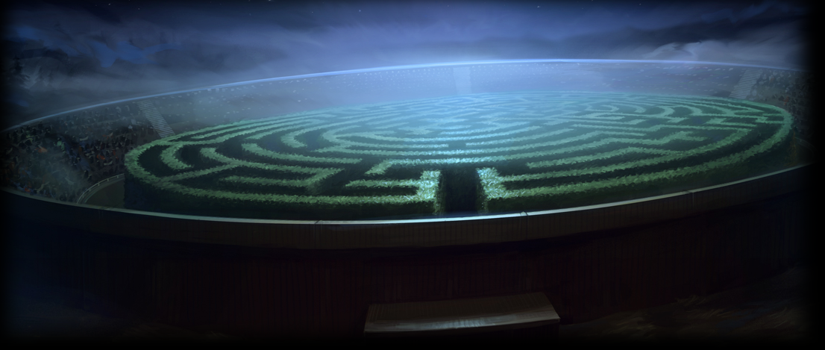
“Harry Potter”

Slide 5
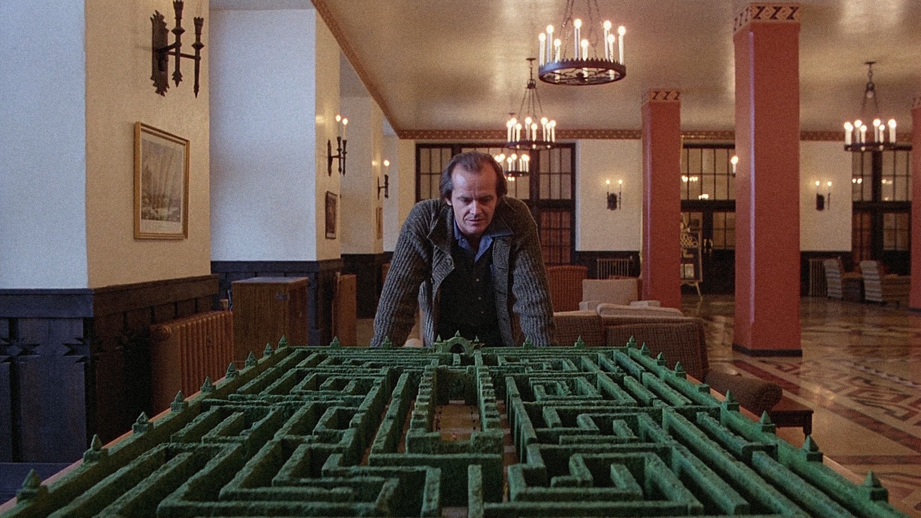
“The Shining”

Slide 6
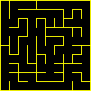
Terms
Perfect – Every cell can reach every other cell by exactly one path
No Loops
No self intersections
‘Spanning Tree’
Braid
Loops, intersections
We won’t build these today
Texture – The ‘feel’ of the maze
Bias – If the maze favours a given direction / shape

Slide 7
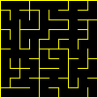
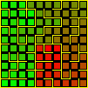
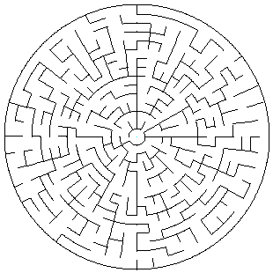
Today
Generate mazes
Binary Tree
Random Walk
Visualize ‘Texture’
Use a simplified Djikstra algorithm to find cell distances
Display distance as color
Compare the algorithms
Not Today…
Generate Polar Maze with either of the above

Slide 8
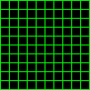
Structure
Think about a grid of cells, and how to represent them
Links between cells
Cell->neighbours[4]
Cell->holes[4]
Grid
Cells[Width][Height]
Coordinates
x, y
0,0
1, 0
0,1
1,1

Slide 9
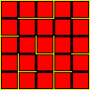
Drawing
ASCII Art
X0X00X
X00X00
X00000
https://github.com/YorkCodeDojo/mazes
Drawing Lines, Circles, Arcs, Boxes to Bitmap in cross-platform C++
Drawing Lines, Circles, Boxes to screen F#, C#, Windows
http://www.nerdparadise.com/tech/python/pygame/basics/part1
Python game library
pygame.draw.rect(screen, (0, 128, 255), pygame.Rect(30, 30, 60, 60))
Edges & Boxes

Slide 10
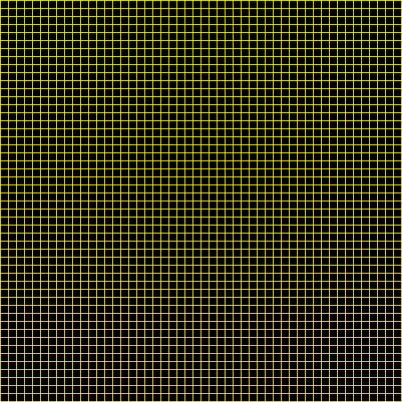
First, draw this….

Slide 11
Part 1 - Binary Tree Maze Generation
Visit all cells, in any order
Make a wall in either the east or north side (random)
Pick ‘the other’ wall if you are at an edge
Draw it!
How does it look?
Any obvious features?
Run the algorithm a few times to get a feel.

Slide 12
Part 2 – Random Walk Maze Generation
Start at a random cell
Pick a random direction to walk in (skip edge cases)
Have you never visited the target cell?
Make a ‘hole’ in the target direction and walk through it.
Otherwise - walk in anyway, but don’t make a hole
Keep going until all cells have been visited (many times!)
Draw it
How does this compare to Binary Tree?

Slide 13
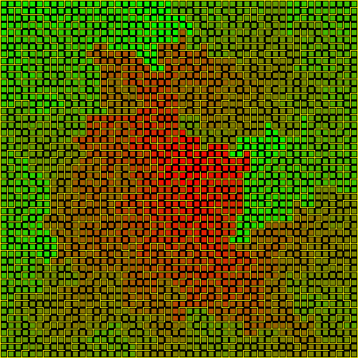
Part 3 - Visualizing Maze Texture
Set CurrentDistance = 0
Walk to all possible neighbours
Mark them CurrentDistance + 1
When all visited, move to the next neighbour and repeat
5. Generate color value based on distance
“Flood Filling”

Slide 14
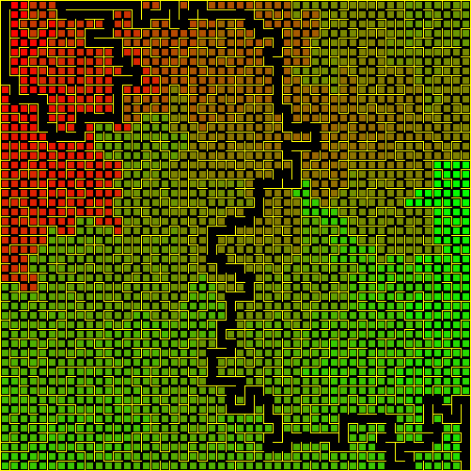
Part 4 – Long/Short Path
Using the distance you’ve generated, you can figure out:
A path between 2 points
Just start at the end, and find a falling sequence of distance values back to 0
The longest path in the maze
- Find the longest distance from a point to another point, then find the longest distance from _that_ point.

Slide 15
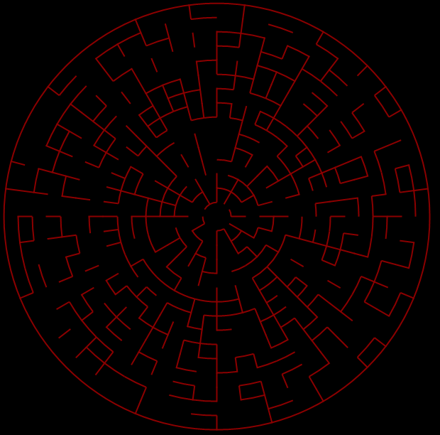
Part 5 – Homework?
Coordinate system:
Ring, Sector – Polar
Challenges:
Subdividing the rings (otherwise looks bad)
Drawing arcs/Circle?
Some cells have 2 exits rimward…

Slide 16
Meetings!
York Game Developers, 3rd Thursday
https://www.facebook.com/groups/YorkGameDevelopers
York Developers
http://www.meetup.com/YorkDevelopers

Slide 17
Slack – York Developer Community
Mail me, David or Daniel to get on the group
yorkdevelopers.slack.com
For coders in the York area
Channels for #gamedev, #codeandcoffee, #yorkcodedojo,#development,….

Slide 18
Questions ?

